Slide 1
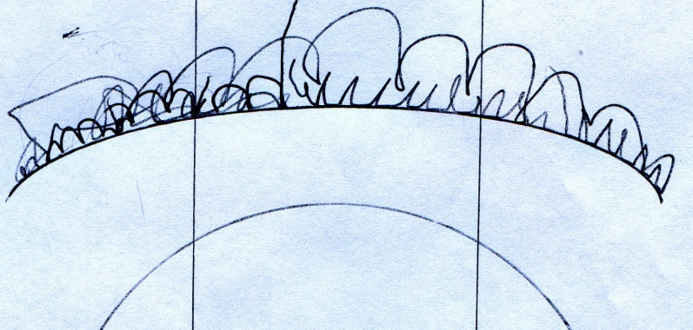
Praxim Haptic Emulation of 3D Hard Surfaces
TEAM
Erica Wodzak
Davy Chiu
David Mountford
Ibrahim Gadala
Nicholas Adams

Slide 2
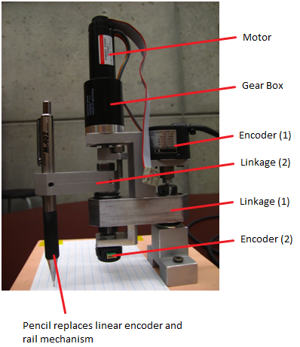
Outline
Project background
Dynamic Physical Constraint concept
Functional Decomposition
Concepts
Counter weight
Motor
Friction
Damper
Spring
Summary

Slide 3
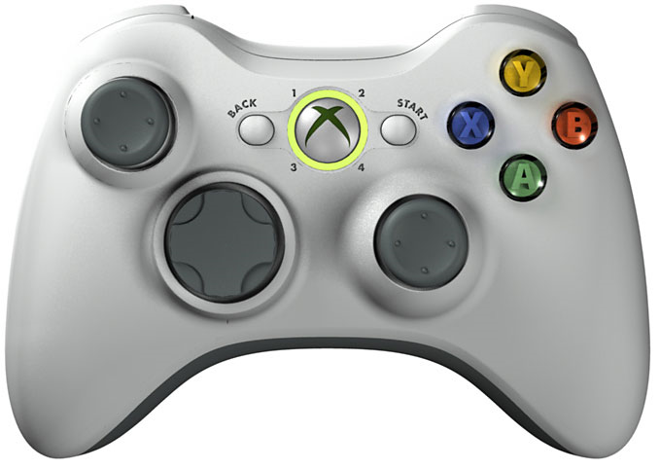
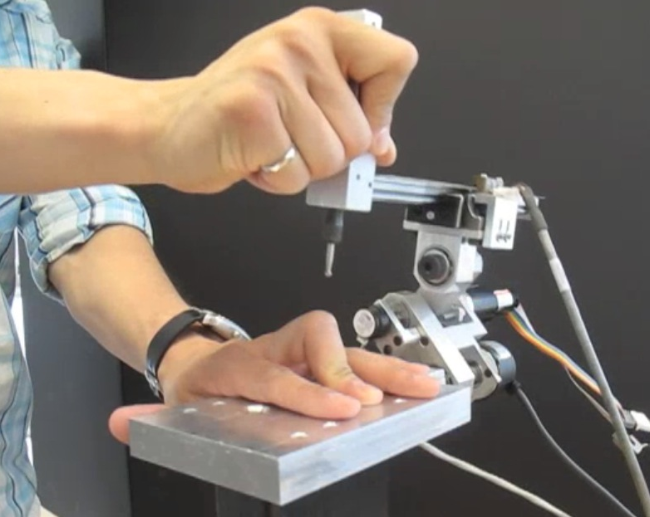
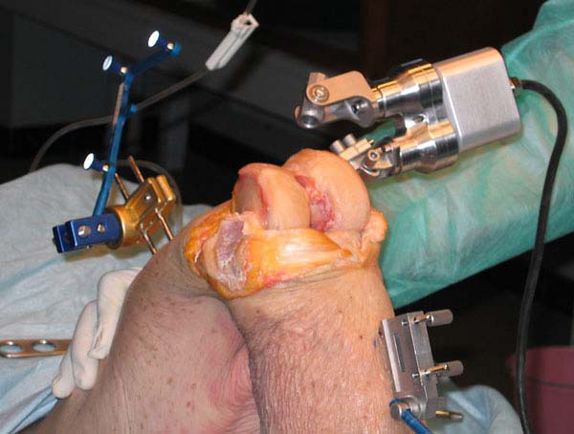
Project Background

Slide 4
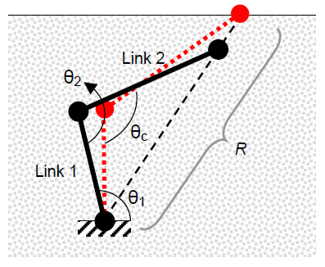
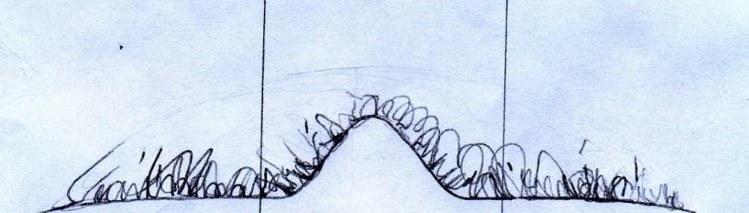
Dynamic Physical Constraint Concept

